Slide 1
DESCRIBE CORE AZURE IDENTITY SERVICES

Slide 2
Agenda
Azure Active Directory
Multi-factor authentication

Slide 3
Azure Active Directory
Azure AD isn’t the cloud-equivalent of Windows Active Directory. It’s entirely different.
Azure AD is a cloud-based identity service in Azure that can help you to authenticate and authorize users. You can use Azure AD to give users access to Azure resources. You can also give users access to third-party resources used by your company and on-premises resources, all using the same username and password.
The core of Azure AD is a directory of users. Each user has an identity that’s comprised of a user ID, a password, and other properties. Users also have one or more directory roles assigned to them. The user ID and password are used to authenticate the user, and the roles are used for authorization to perform certain activities in Azure AD.
When you sign up for an Azure subscription, an Azure AD resource is automatically created for you, and it’s used to control access to Azure resources you create under your subscription.

Slide 4
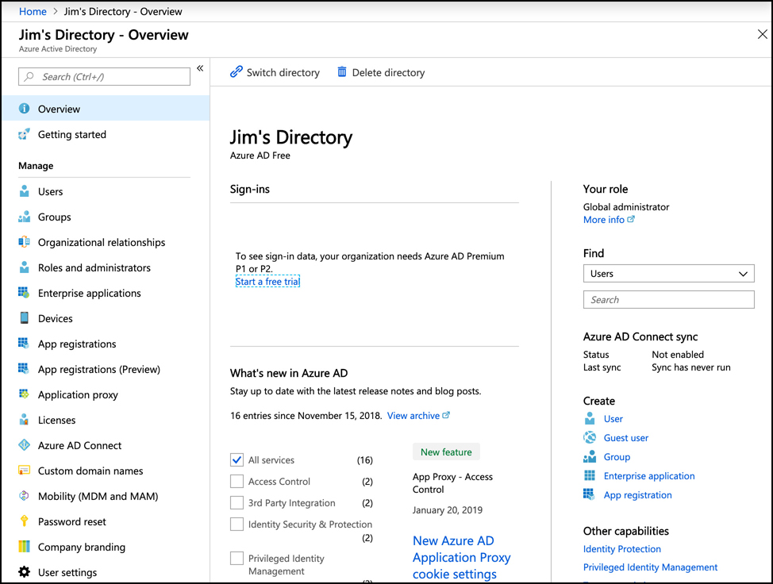
Azure Active Directory
To view or manage users in Azure AD, click on Users in the menu on the left side of the page

Slide 5
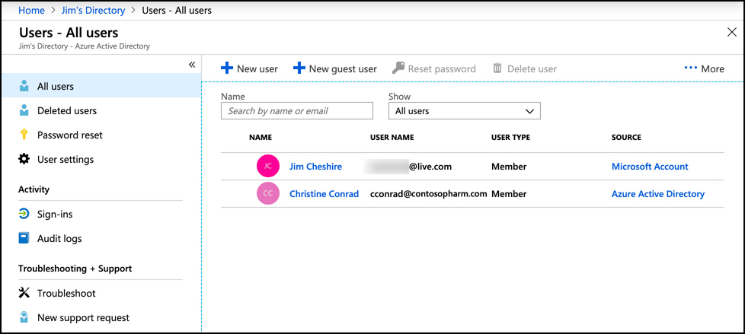
Azure Active Directory
To view or manage users in Azure AD, click on Users in the menu on the left side of the page.
The Azure AD shown contains two users. The first user’s source is Microsoft Account, meaning this user is tied to a Microsoft Account email address. The other user is an Azure Active Directory user that was manually added.

Slide 6
Azure Active Directory
To add a new user from your company to your Azure AD, click on New User.
The specified user name is used to log into Azure AD. The domain name you use must be one that you own and that is associated with your Azure AD. You can also click on Groups to pick a group for this user. Groups makes it easier to manage larger groups of similar users.
Azure AD offers a feature called Azure AD B2B (business-to-business) collaboration that allows you to add users who don’t belong to your company. So, you can invite other users from outside of your company to be members of your Azure AD. Those users can then be given access to your resources. Users who are not part of your company are called guest users.
To add a guest user, click New Guest User
When you invite a guest user, an invitation to join your Azure AD is sent to the email address you specify. In order to accept the invite, the user’s email address must be associated with a Microsoft Account. If the user doesn’t have a Microsoft Account, they’ll be given the option to create one so they can join your Azure AD.

Slide 7
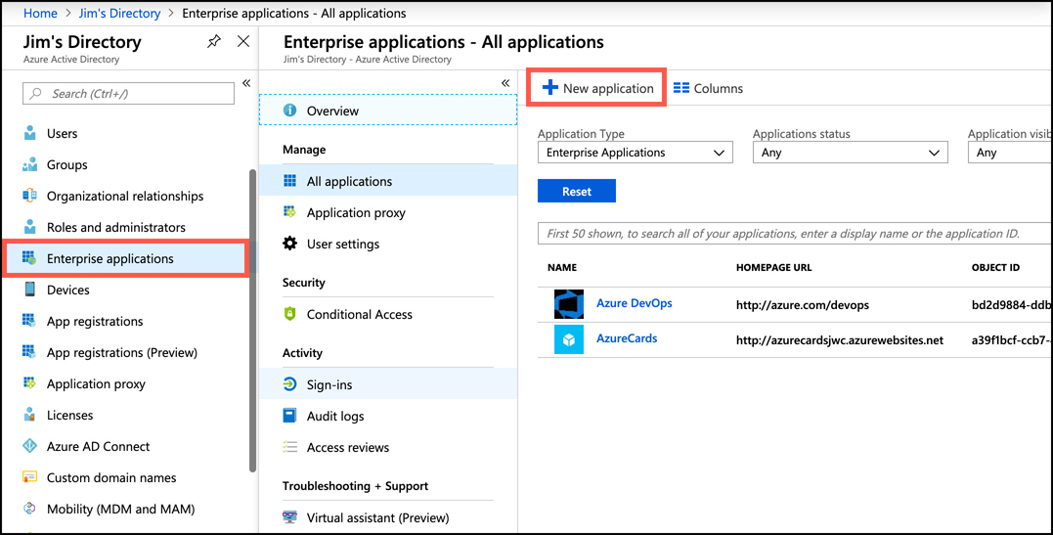
Azure Active Directory
The user can be given access to the corporate social media accounts by adding those applications to Azure AD. Applications to add include, not only social media applications such as Facebook and Twitter, but also thousands of others. To add an application, open Azure AD in the Azure portal, click Enterprise Applications, and click New Application
After you click on New Application, you can choose from a list of included applications. You can also add your own application, add an application that exists in your on-premises environment, or integrate any other application. The application that you add needs to expose a login page that you can point Azure AD to in order to integrate it.

Slide 8
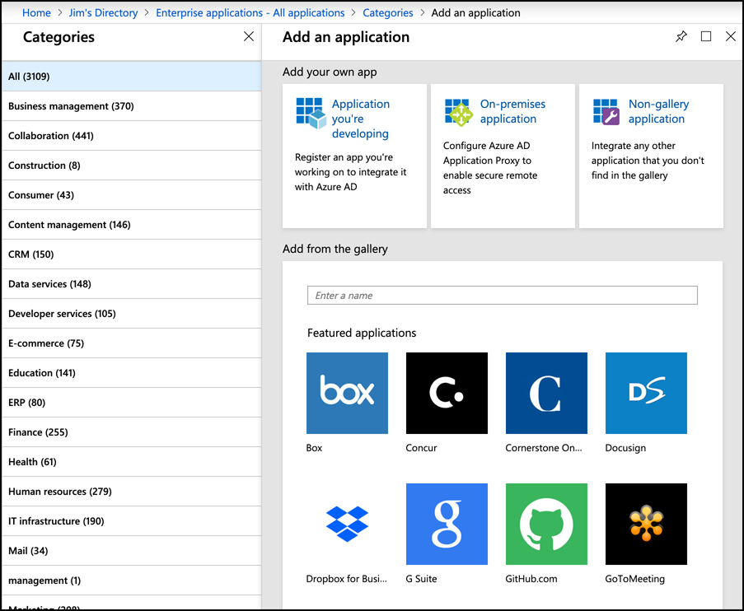
Azure Active Directory
After you add an application, you can configure Azure AD so that users with access to that application can authenticate to it using the same credentials they use to log into Azure AD. This kind of authentication is known as single sign-on (or SSO), and it’s one of the key benefits to using Azure AD

Slide 9
Azure Active Directory
Another AD feature called Azure AD B2C allows you to give users access to Azure AD applications by signing in with existing accounts such as a Facebook or Google account.
Another important benefit to using Azure AD for managing user access to other applications is that you can easily revoke that access from a single interface. For example, if you give a user the username and password of your social media account so they can post to your account, when you no longer want that user to have access, you’d have to change the username and password on your social media account. If, however, you grant them access using Azure AD with SSO configured, you can remove that access easily within the Azure portal. The user never has to know the username and password you use for the social media account.

Slide 10
Agenda
Azure Active Directory
Multi-factor authentication

Slide 11
Multi-factor authentication
Azure AD has three other pricing tiers that aren’t free: Basic, Premium P1, and Premium P2. If you upgrade to one of the Premium plans, you have the ability to enable multi-factor authentication for your users.
If you’re using the free Azure AD plan, you have a subset of MFA features for global administrators only. These features allow you to enable MFA for global administrators when accessing the Azure portal and the Microsoft 365 admin center.

Slide 12
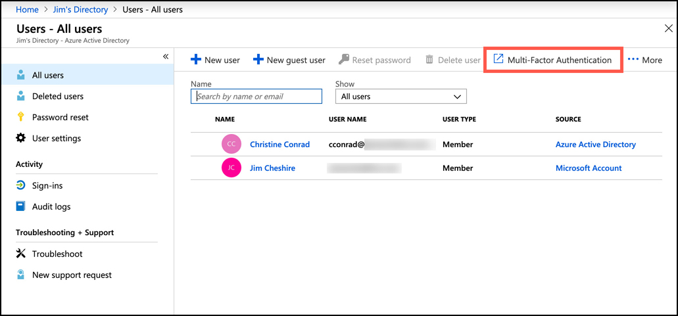
Multi-factor authentication
To enable multi-factor authentication for one or more users of your Azure AD, open the All Users blade and click on Multi-Factor Authentication.

Slide 13
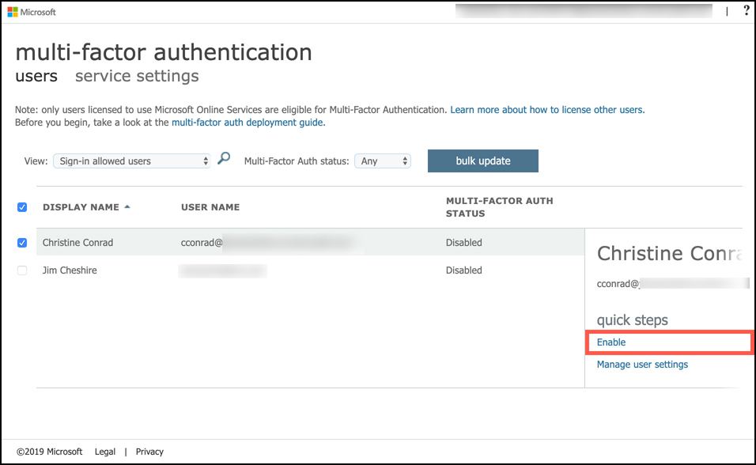
Multi-factor authentication
When you click on Multi-Factor Authentication, a new browser window opens and displays the Azure AD user management site. Select one or more users you want to enable multi-factor authentication for and click Enable.

Slide 14
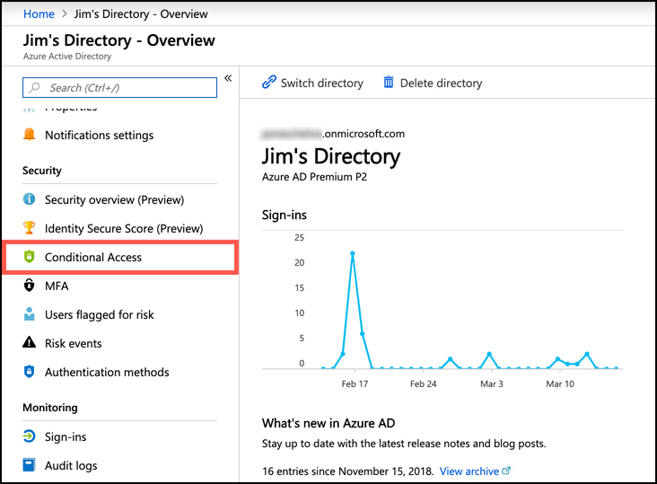
Multi-factor authentication
You can’t enable multi-factor authentication for guest users using this method. If you want to enforce multi-factor authentication for guest users, you will need to set up conditional access to your Azure AD. To do that, open your Azure AD in the Azure portal and click on Conditional Access.
In the Conditional Access blade, click New Policy

Slide 15
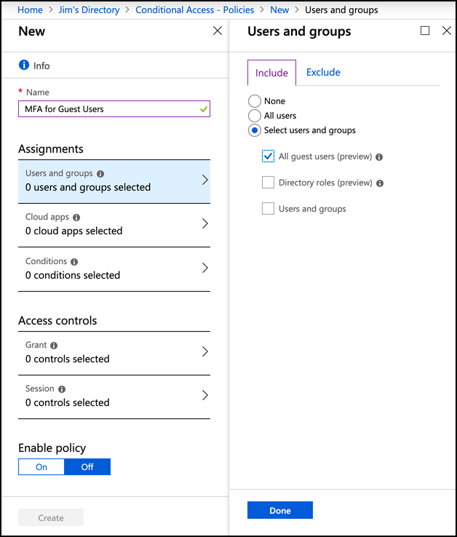
Multi-factor authentication
Enter a name for the new policy and click Users and Groups under Assignments. Click the Select Users and Groups radio button and check the All Guest Users checkbox. Then click Done

Slide 16
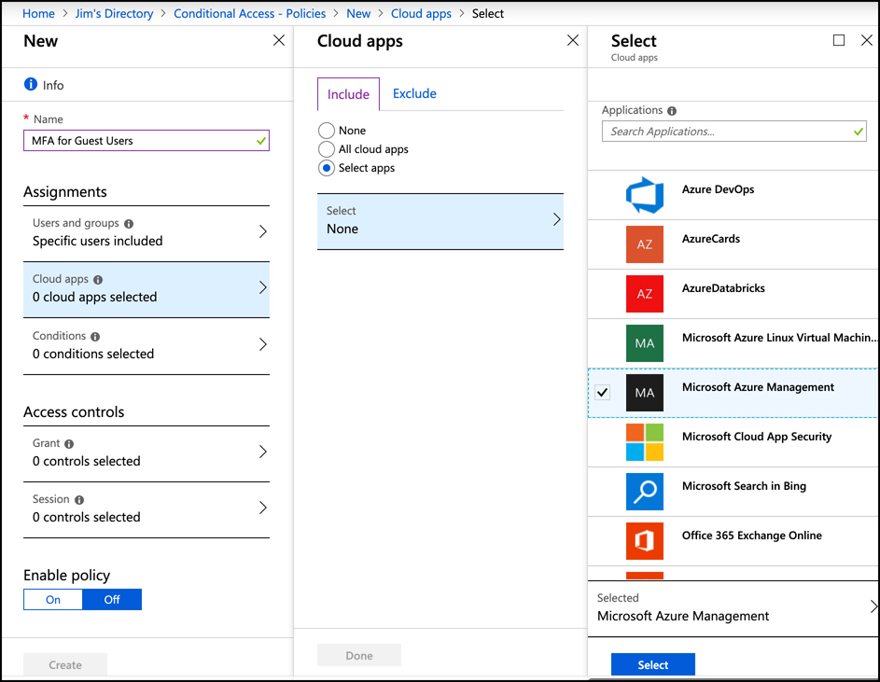
Multi-factor authentication
You now need to configure which app this policy applies to. Click Cloud Apps.
Click the Select Apps radio button.
Click Select.
Select the Microsoft Azure Management app.
Click Select.

Slide 17
Multi-factor authentication
To add a multi-factor authentication requirement to the policy:
Click on Grant under Access Controls.
Click Grant Access and check the Require Multi-Factor Authentication checkbox.
You’ll then need to click Select to add the access control.
Finally, enable the policy and click Create to finish the process.

